Slide 1
CLUSTERING NEIGHBORHOODS IN CITY OF TORONTO
REASONS FOR SHIFTING CAN BE MULTIFOLD:
current place is far away from work
we might have to shift if current place is far away from our kid’s school,
we might have to shift as the rent we have to pay at current locality might have increased
It is quite common that we might feel out of place if we shift to a locality, which is not very similar to our neighborhood
In this project we are trying to identify similar neighborhoods in city of Toronto and we are trying to recommend a list of similar localities a person can shift in city of Toronto if at all he has to shift from his current neighborhood

Slide 2
Data
Using the following link,
https://en.wikipedia.org/wiki/List_of_postal_codes_of_Canada:_M, we are going to gather data of neighborhoods and their corresponding postal codes and boroughs
Using the following link, http://cocl.us/Geospatial_data, we gonna gather data of corresponding latitude and longitude
Then using four square API, we are going to gather near by venues in each neighborhood of Toronto and use this data to cluster neighborhoods in city of Toronto
Each cluster represents similar neighborhood and using this criteria we will define similar neighborhoods into which a person can move

Slide 3
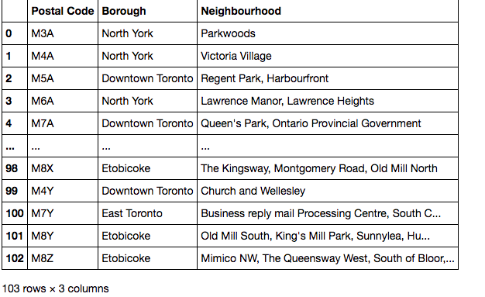
Methodology:
The dataframe will consist of three columns: PostalCode, Borough, and Neighborhood
Only process the cells that have an assigned borough. Ignore cells with a borough that is Not assigned.
If a cell has a borough but a Not assigned neighborhood, then the neighborhood will be the same as the borough.

Slide 4
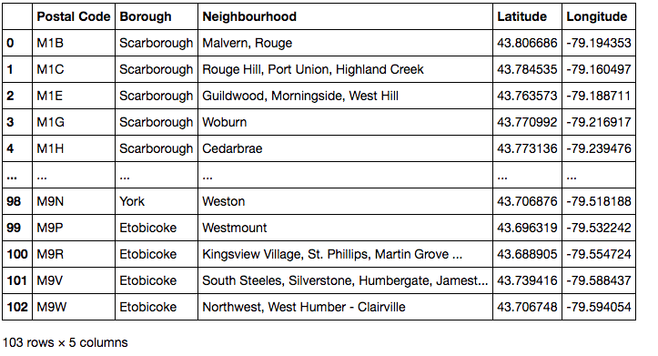
csv file that has the geographical coordinates of each postal code: http://cocl.us/Geospatial_data
Use the Geocoder package or the csv file to create the following dataframe

Slide 5
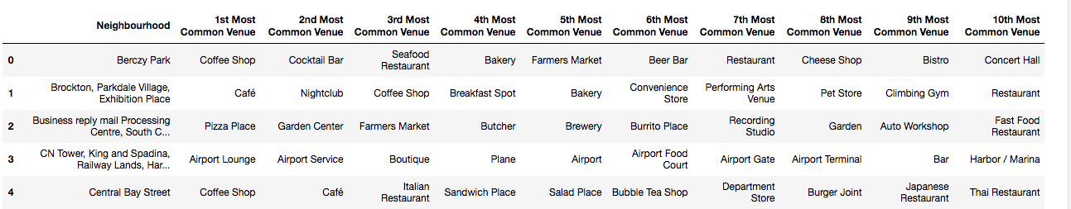
Explore and cluster the neighborhoods in Toronto using k-means and four square API
Work with boroughs that contain the word Toronto.
No of clusters=5

Slide 6
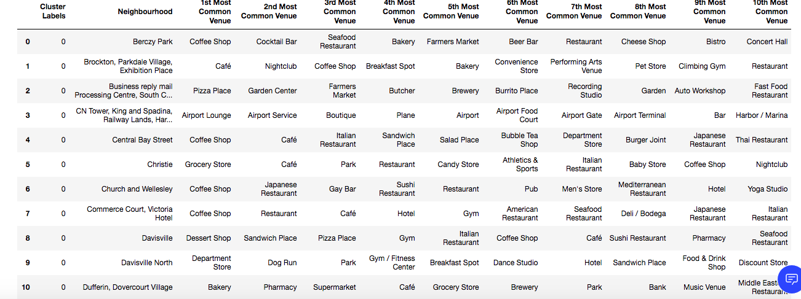
Results:
Neighborhoods and clusters labels

Slide 7
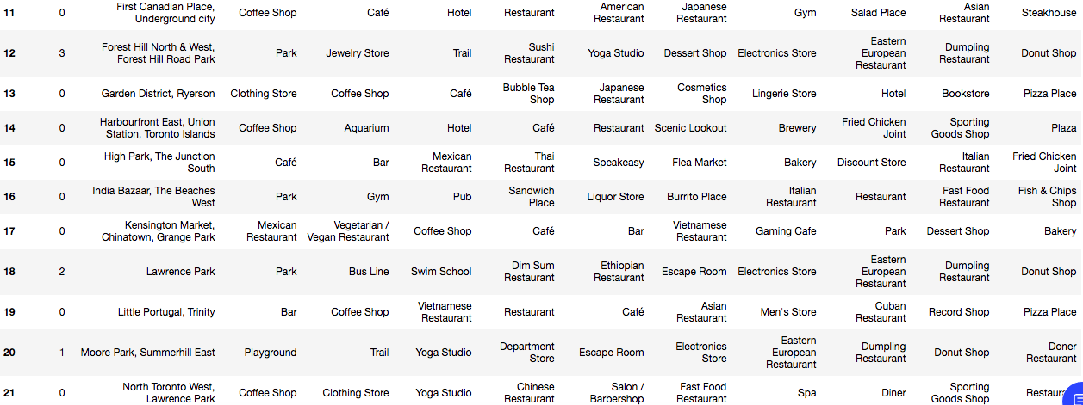

Slide 8
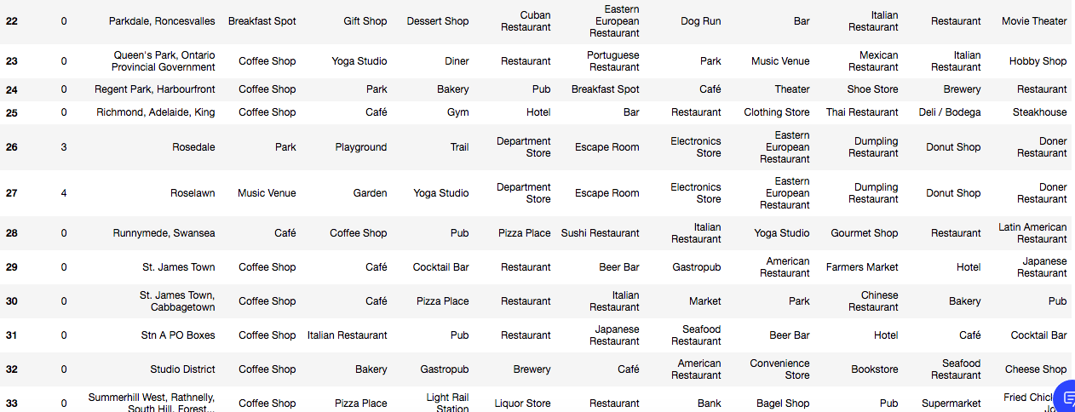

Slide 9
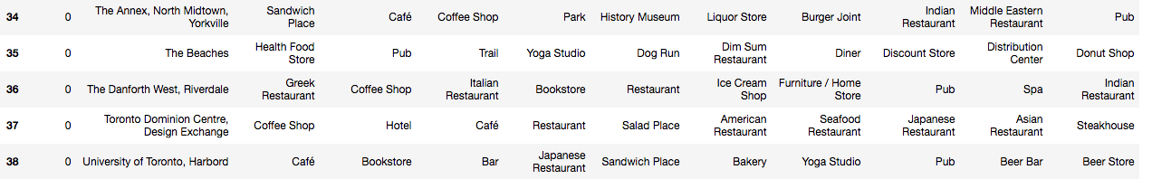

Slide 10
Discussion:
all neighborhoods with cluster label 1 are similar
all neighborhoods with cluster label 2 are similar
all neighborhoods with cluster label 3 are similar
all neighborhoods with cluster label 4 are similar
People in same cluster neighborhood should prefer similar neighborhood in same cluster if they shouldn’t feel out of place
Most neighborhoods are in cluster 0

Slide 11
Conclusion:
Using k means clustering we were able to divide neighborhoods in Toronto city into 5 clusters .We found that most number of neighborhoods are in cluster 0

